Slide 1

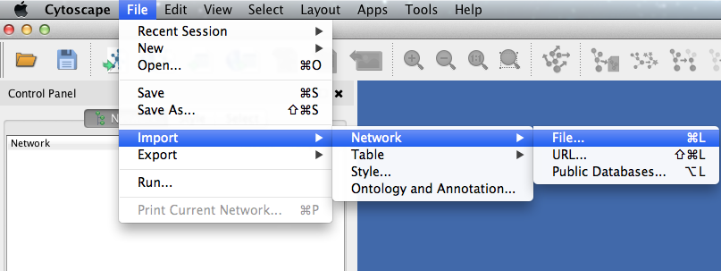
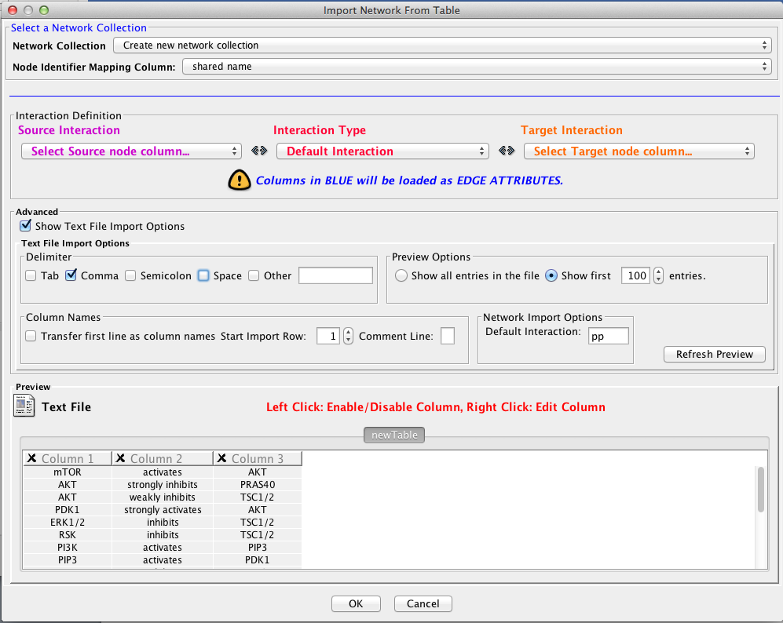
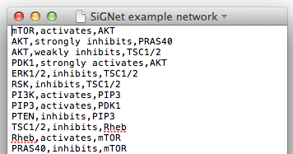
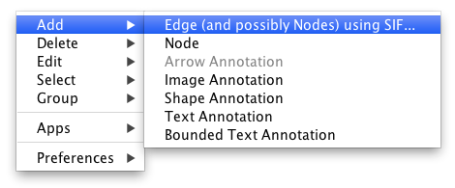
SiGNet User Guide
SiGNet is a tool for simulating biological data for a signalling network of known structure. This data can then be used for benchmarking of inference strategies by performing inference on the simulated data and scoring the predictions against the gold standard, known network structure. This user guide illustrates a typical use case.
(a)
(b)
1. Import a network into Cytoscape in a .sif format table (a), or draw it out (b). Interactions should be in the format ‘node 1, interaction, node 2’, with the interaction being one of the following terms: ‘activates’, ‘strongly activates’, ‘weakly activates’, ‘inhibits’, ‘strongly inhibits’, ‘weakly inhibits’ or ‘binds’ (for interactions that do not affect the activity of the target node). If the interaction is left blank or does not match this controlled vocabulary, SiGNet will replace the interaction with ‘activates’ and warn the user that this has occurred.

Slide 2
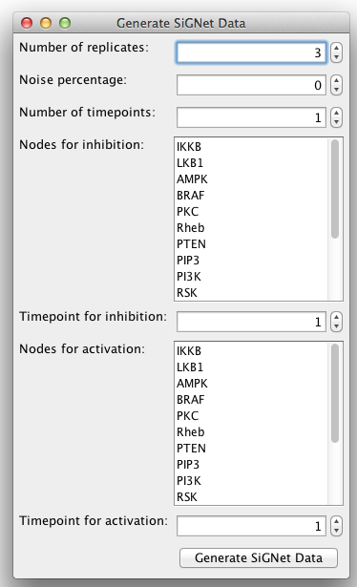
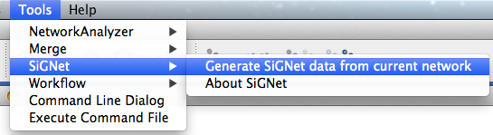
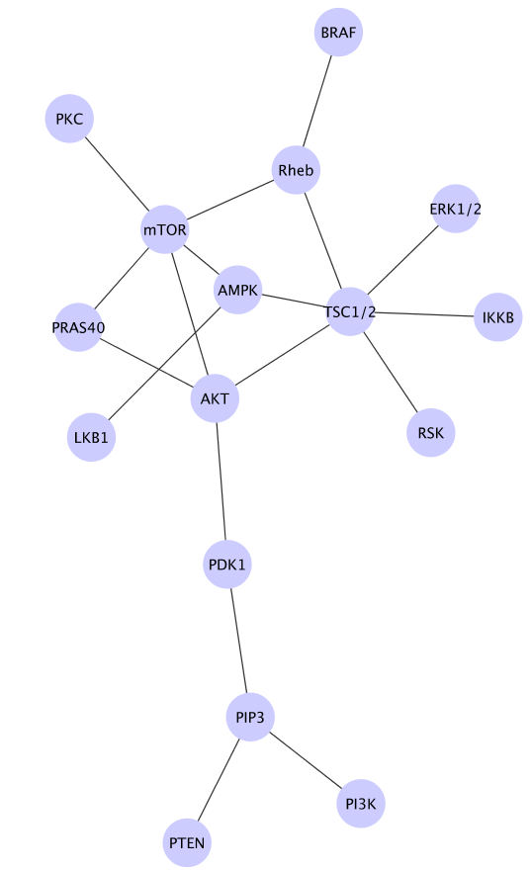
2. Click ‘Tools’ in the Cytoscape toolbar, then ‘SiGNet ‘and ‘Generate SiGNet data from current network’. In the popup menu, select the number of ‘experimental replicates’ required, the level of noise in the system (if required), the number of timepoints and whether any nodes should be inhibited or activated, and when. When you are happy with the parameters displayed, click ‘Generate SiGNet Data’.

Slide 3
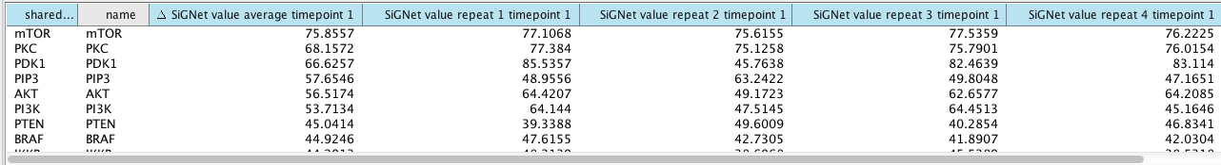
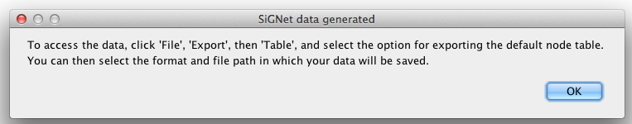
3. The SiGNet algorithm now runs and populates the node table with data for each node at each replicate and at each time point, along with node averages for each time point. A pop up message will appear explaining how to export the data.
In the network shown here, nodes have been coloured according to their SiGNet average value for timepoint 1 – this can be achieved using the ‘Style – Node’ tab under the Cytoscape Control Panel.

Slide 4
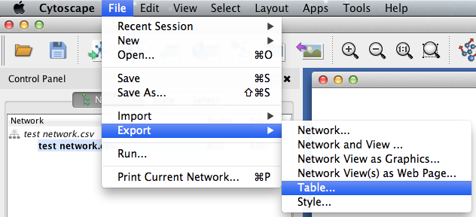
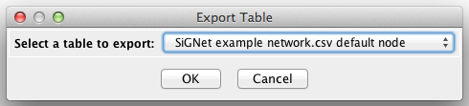
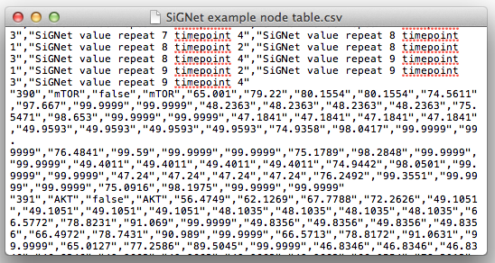
✓
✓
4. By clicking ‘File’, ‘Export’ , ‘Table’ and then selecting the default node table to export, the SiGNet data you have generated will be exported to the location you specify. These data files can then be used for network inference, the results of which can be scored against the network of interactions used in Step 1.
Please remember to cite SiGNet as follows: xxxxxxxx

